Slide 1
New York City AIRBNB
Jeff Klima
Kenny Cutler
Linn Slater

Slide 2
Project goal
5 boroughs
Manhattan
Brooklyn
Bronx
Queens
Staten Island
3 room types
Entire home/apartment
Private room
Shared room
Predict price of an Airbnb in NYC based on borough and room type

Slide 3
Dataset
Kaggle
.csv file scraped from Airbnb website
New York City data – 2011 to 2019
Listing activity
Metrics
Data cleanup
$0 listings
Listings greater than $1,000 per night

Slide 4
Machine Learning Journey
Stop 1: Linear regression
Reshaped y data (price)
Not categorical data
Residuals only plot between 0 and 1 on x-axis
Stop 2: Sequential Model (Neural Networks)
One model for each room type
Classification model
Predicts 2 prices – high and low
Stop 3: Back to Linear Regression we go!
No scaler on y data (price)
Seaborn for residual plot

Slide 5
Machine learning steps
Jupyter Notebook/Pandas
Load and manipulate data
Sci-kit Learn - Supervised Learning - Linear Regression
train_test_split
Create training and testing data
StandardScaler on X
Fit the model to scaled training data
Predictions using scaled testing data
Quantified the model using scaled data
Regression analysis
Ridge
Lasso
Elastic Net

Slide 6
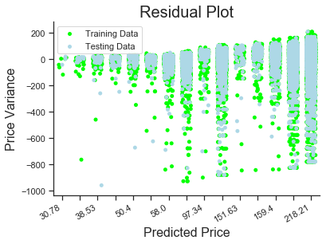
Residual Plot
Overlapping plot points
Difficult to read and understand
Seaborn stripplot with jitter
Adds noise to the graph for clearer picture
Given more time, we would have experimented with other types of graphs in an effort to better illustrate the results.

Slide 7
Results
Standard Linear Regression
MSE with Y_train: 9776.3319
MSE with X_test, Y_test: 10324.5386
Lasso
MSE: 10325.1153, R2: 0.273604
Ridge Regression
MSE: 10325.0724, R2: 0.273607
Elastic-Net
MSE: 10325.5492, R2: 0.273573

Slide 8
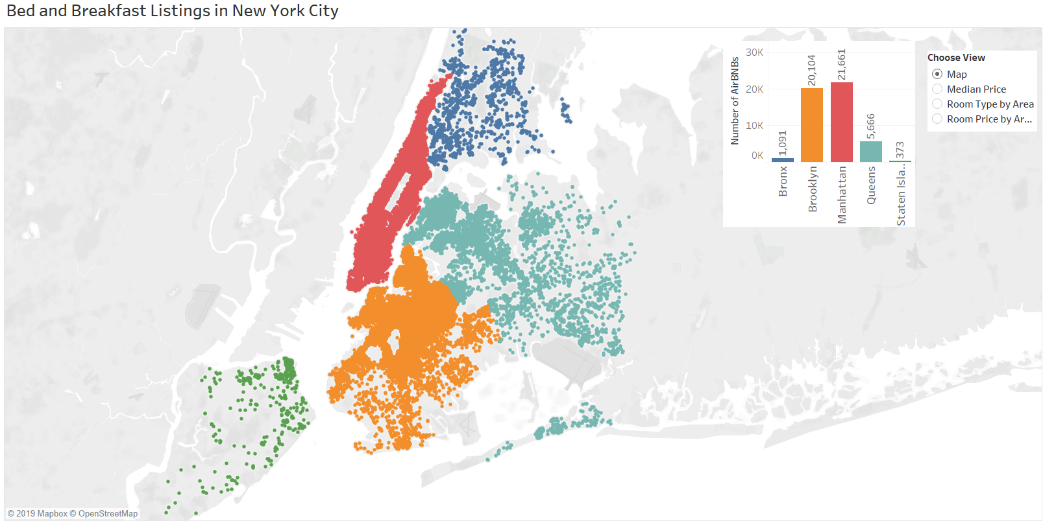

Slide 9
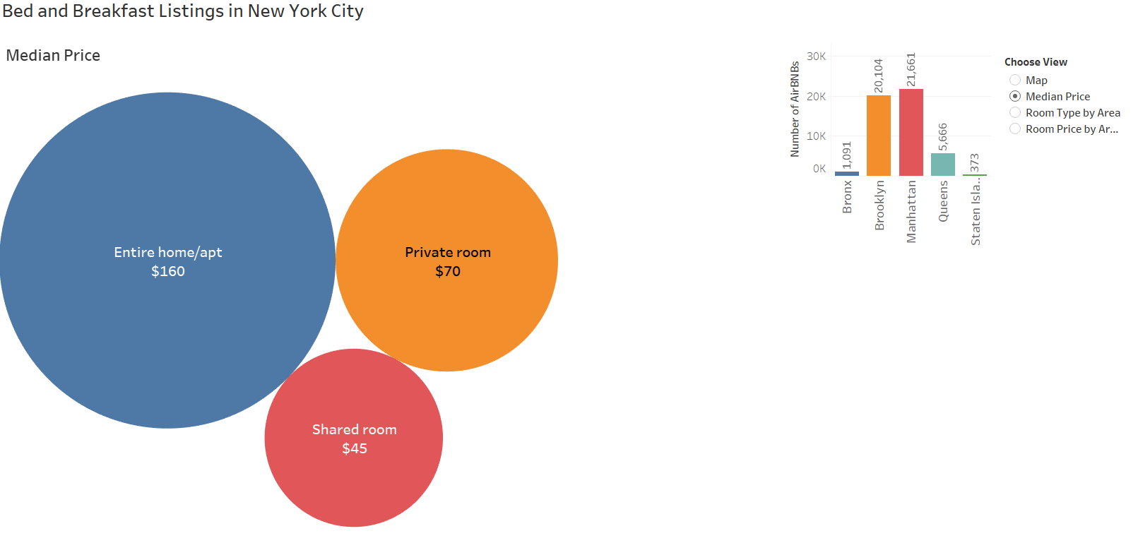

Slide 10
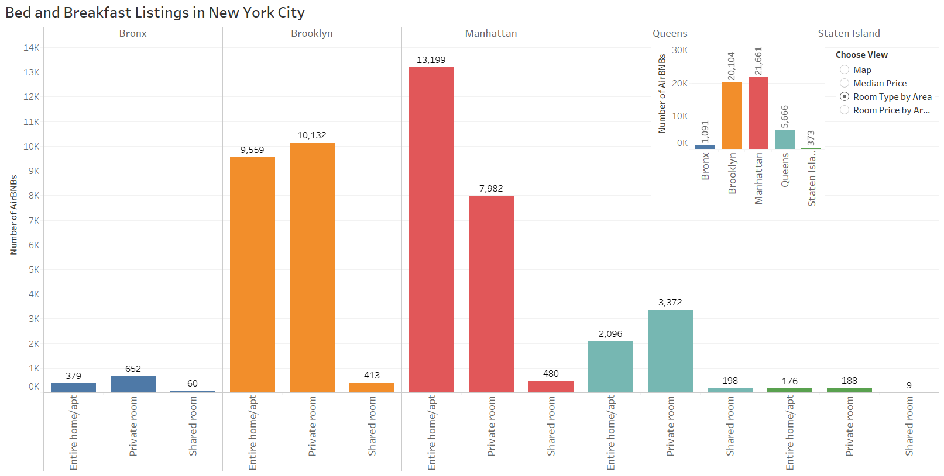

Slide 11
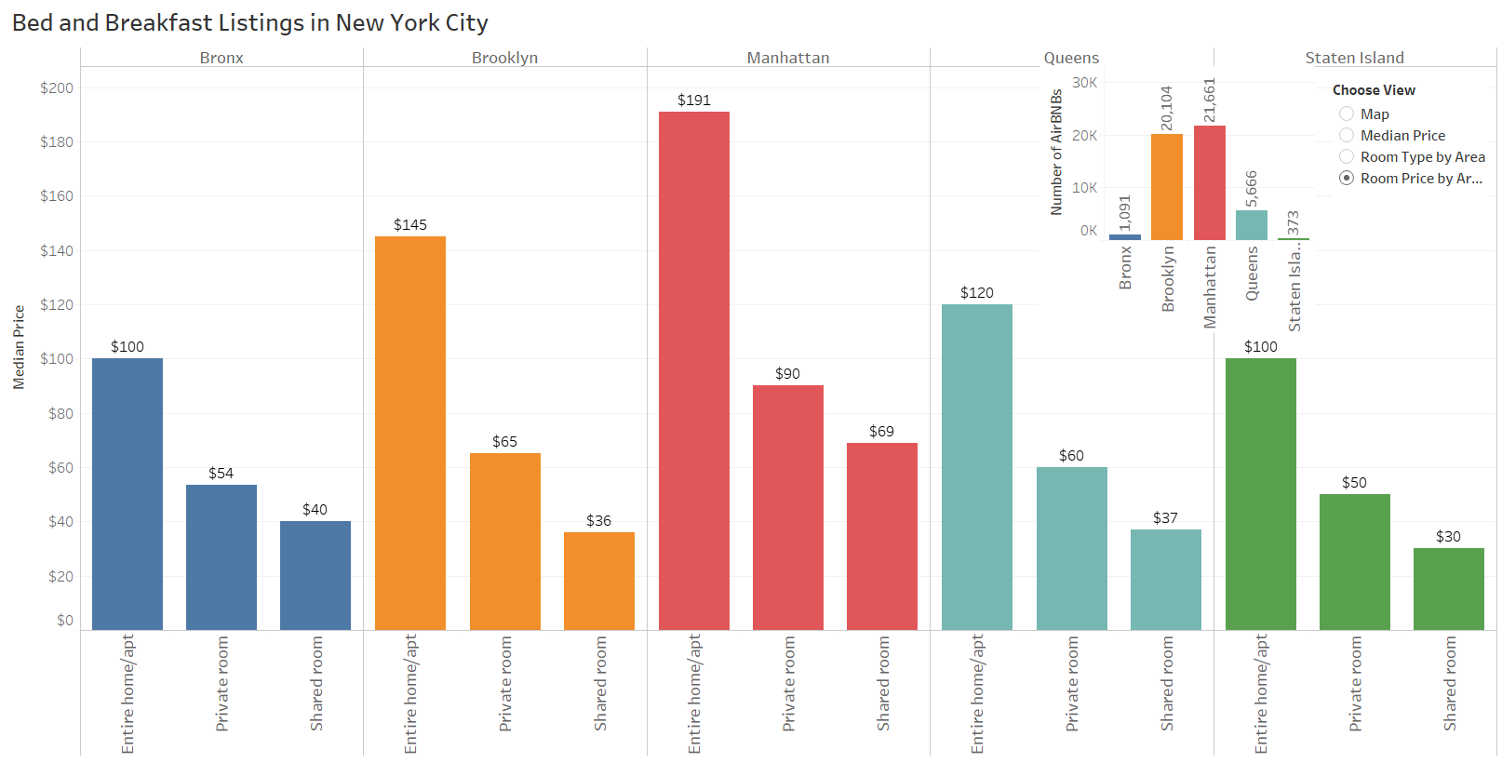

Slide 12
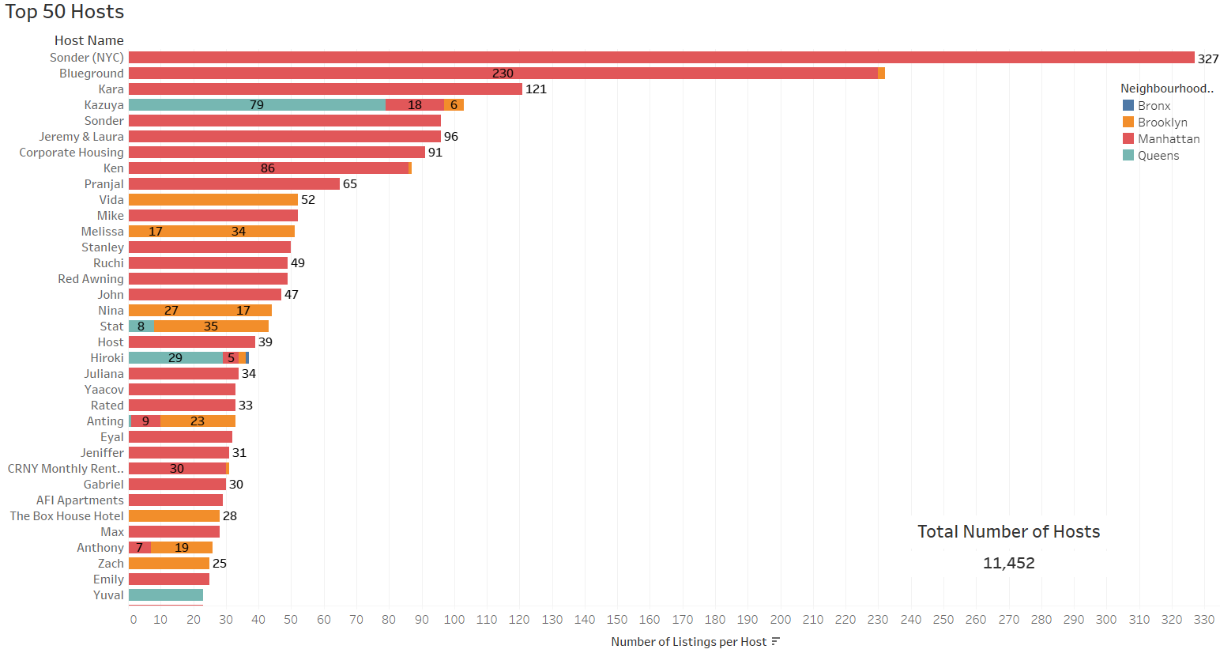

Slide 13
Conclusion
Data lacked adequate explanations
Variables not easily understood
Key information was limited
Could have used information like:
How often listings rent
How long they were rented for
Total number of stays
Predictions outside $90 to $200 range inaccurate

